Slide 1
Charitable Estate Planning What Your Donors Really Want
Eddie Thompson, Ed.D., FCEP
Founder & CEO
www.ceplan.com

Slide 2
strategic
Annual
giving
Capital
Planned

Slide 3
Types of Donors
Strategic
Give Out of Habit
70%
Emotional
Habitual
Give Based on Emotion
23%
Are Strategic Donors
7%

Slide 4
Where are Nonprofits
Looking for Gifts?
Annual
Discretionary Income
?
?
?
?
?
?
?
?
?
?
Planned
Net Worth

Slide 21
three
Questions…
… that must be answered for,
and by, clients who are strategic donors!!!

Slide 22
The three questions
03
Would I rather my executor or trustee write a check from my estate to the IRS, or to my favorite charities?
02
How much should
I leave my heirs?
01
Do I have enough to live on for the rest of my life?

Slide 23
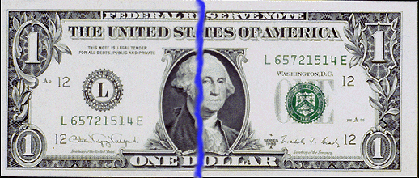
Total wealth
Self-directed charitable gifts
Financial independence
Inheritance for heirs
Government-directed tax

Slide 24
questions
Do the majority of planning clients list philanthropy as the major objective of estate planning?
Are most parents concerned about giving all of their estate outright to heirs?
Are trusts excellent tools for asset protection for heirs?
Would planning clients rather give to the IRS or local charities?

Slide 25
trend
100%
20%
40%
40%
Outright
Annual
Lump
Heirs

Slide 26
Planned
gifts
Planned gifts are often one of the results
of charitable estate planning!

Slide 27
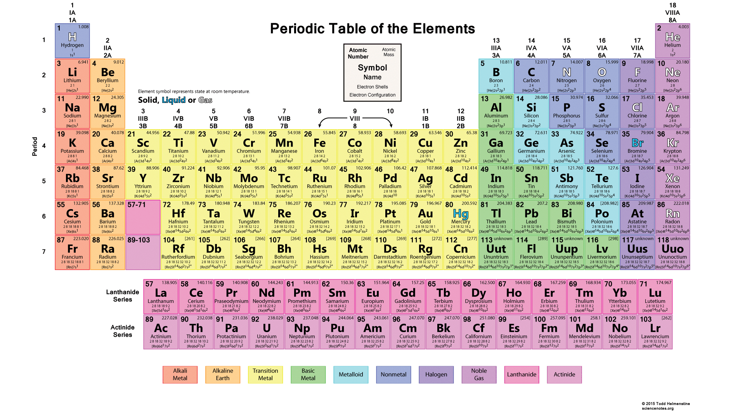
flashback
To chemistry class

Slide 28
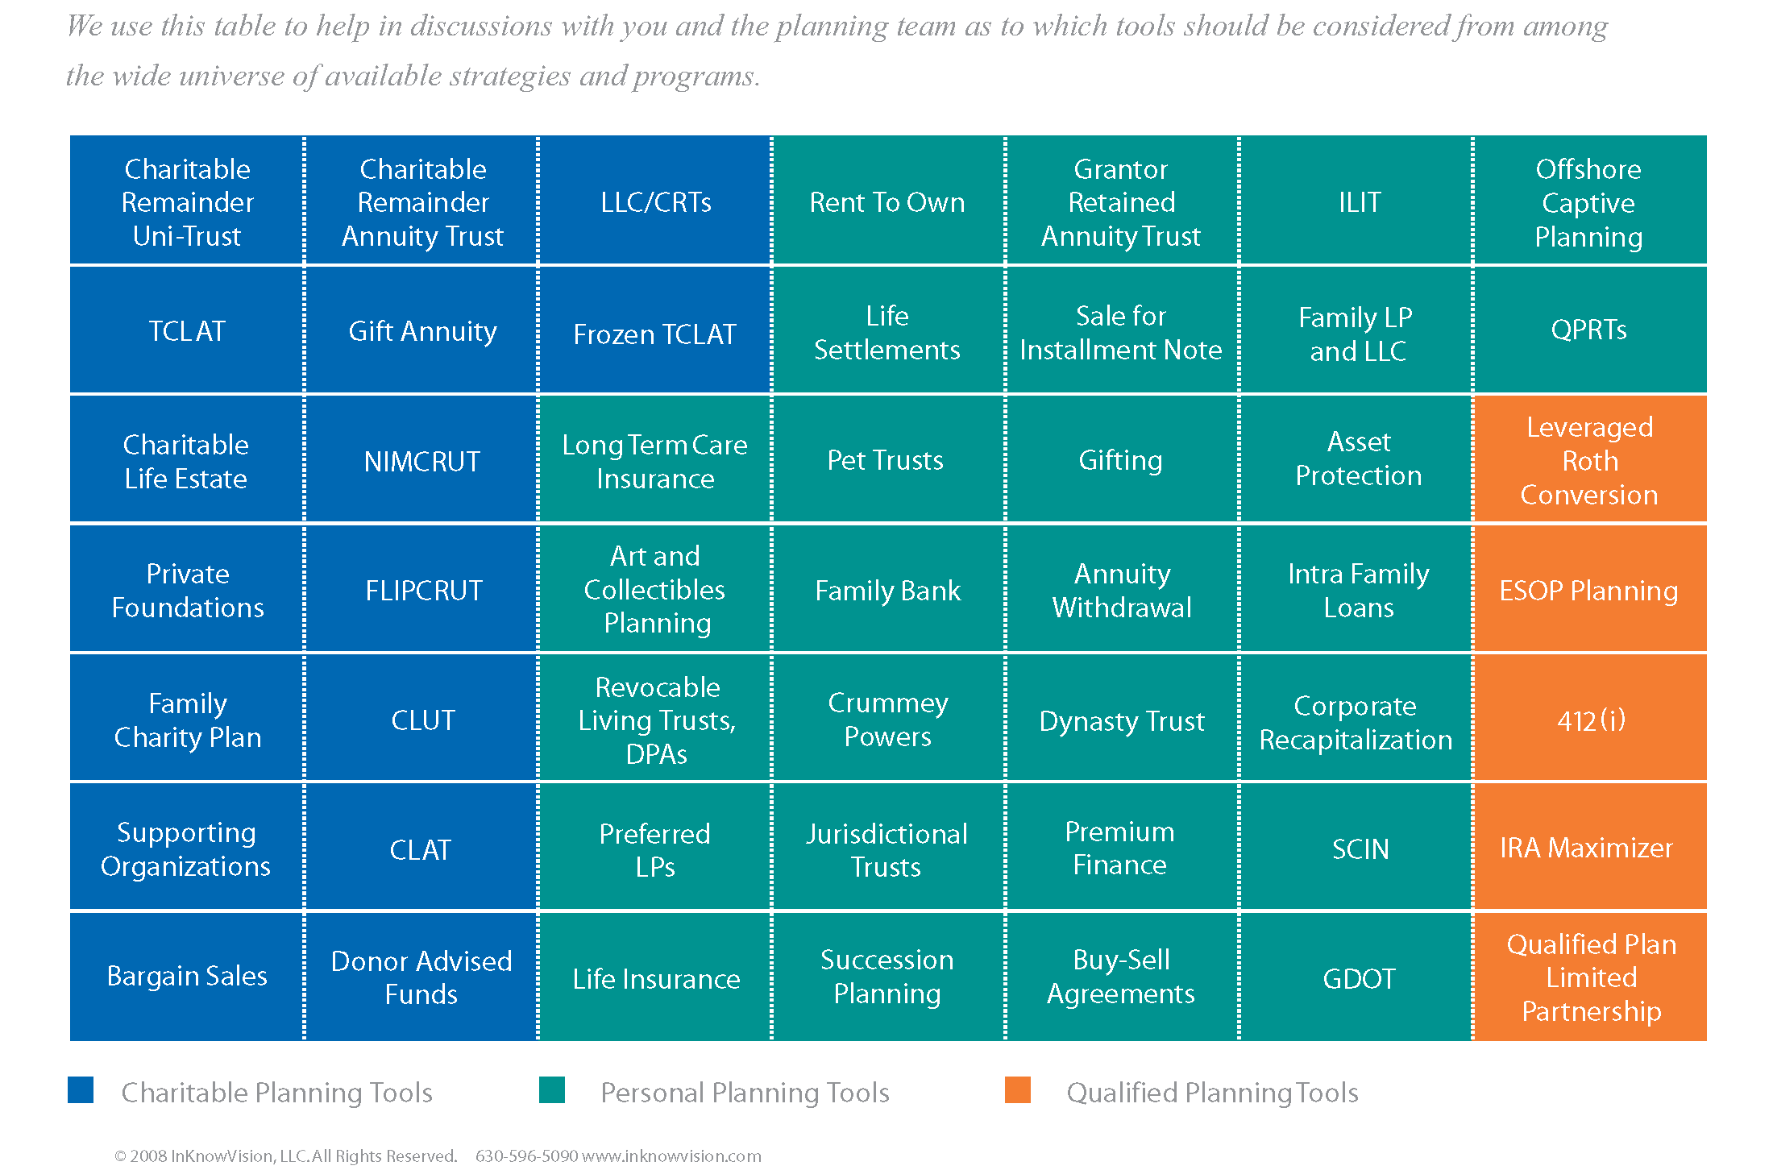
Estate planner’s version

Slide 29
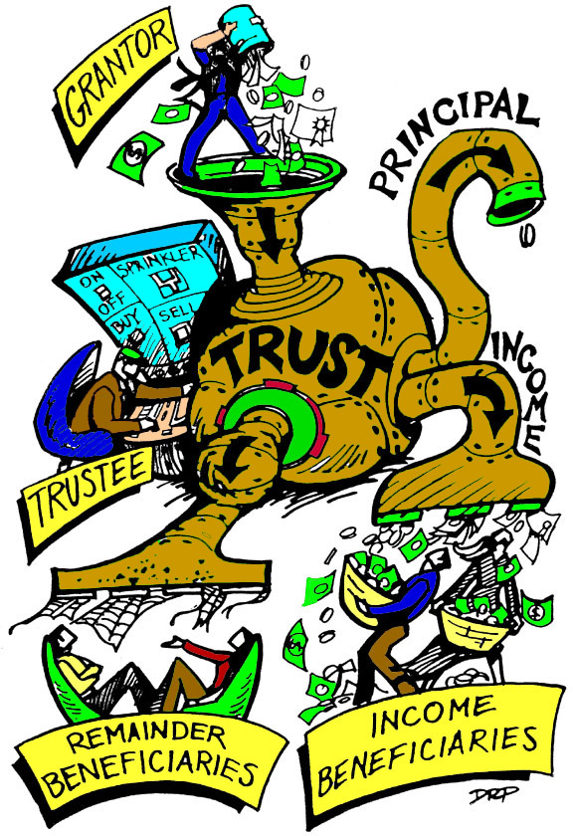
Mechanics
Of a trust

Slide 30
Charitable estate planning
Vs.
traditional planned giving
Traditional Planned Giving
Charitable Estate Planning
Goal is to secure a gift
Informs donor about the benefits of a particular type of gift
Based on the organization’s needs
May generate a gift
Goal is to create the best plan for the donor
Educates donor about how a gift fits into his or her objectives
Based on the values of the donor
Typically results in large gifts
“Our donors appreciate the values-based approach to planning.”
-Attorney & President of Private School

Slide 31
Here’s how we do that….
www.ceplan.com/gift

Slide 32
QUESTIONS?
Eddie Thompson, Ed.D., FCEP
Founder & CEO
www.ceplan.com

